Slide 1



Team 19
CNT Reinforced Ceramics 3D Printer
Midterm II Presentation
Team Members
Ernest Etienne, M.E.
Cody Evans, I.E.
Basak Simal, M.E.
Daphne Solis, I.E.
Sonya Peterson, M.E.
Sam Yang, M.E.
Advisors
Dr. Cheryl Xu, FSU
Dr. Wei Guo, FSU
Dr. Yong Huang, UF
Course Professors
Dr. James Dobbs
Dr. Nikhil Gupta
Dr. Okenwa Okoli
Dr. Chiang Shih

Slide 2
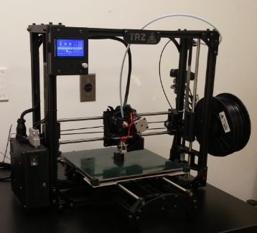
Contents
Scope
Overall Process
Motivation
Experiments
Prototype Assembly
Future Actions
Figure 1. The TAZ 3D printer to be retrofitted.
Daphne Solis

Slide 3
Scope
Liquid Precursor
Cured Solid Polymer
Solid Ceramic Matrix
Modifying an existing 3D printer to extrude a liquid polymer
The polymer must be cured before extruding the next layer
Ultimate Goal: Print a basic 3D object
←Project Scope
Daphne Solis

Slide 4
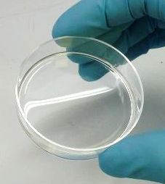
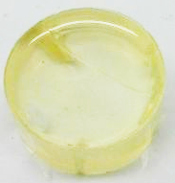
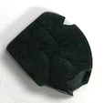
Process
(A)
←Project Scope
(B)
(C)
Figure 2.
(A) Liquid pure polymer
(B) Cured solid polymer matrix
(C) Solid ceramic matrix
Daphne Solis

Slide 5
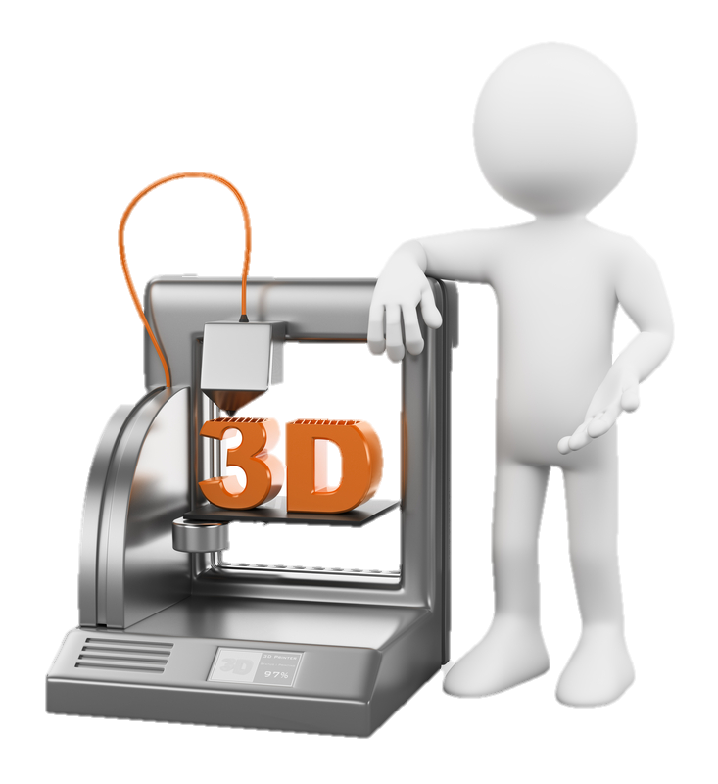
Motivation
Mechanical Properties: ≈26% higher strength
Electrical Properties: Conductivity increases by 25%
Thermal Properties: Increases by 10% along the z-axis
Chemical Properties: Oxidation resistance, higher durability
Daphne Solis

Slide 6
Experiments

Slide 7
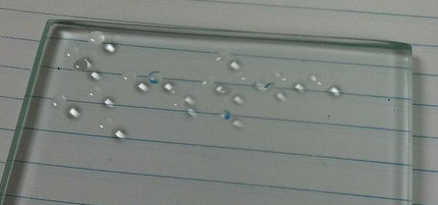
Previous Experiments
Pure polymer mixed with UV curing reagent
Extrusion by droplets
Tested with smallest needle gauge
Used various print stage surfaces
Figure 3.
Extruded droplets of the pure polymer mixed with the UV curing reagent
Samuel Yang

Slide 8
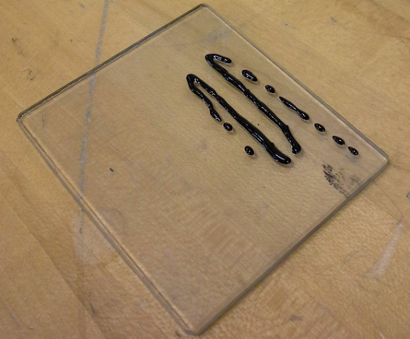
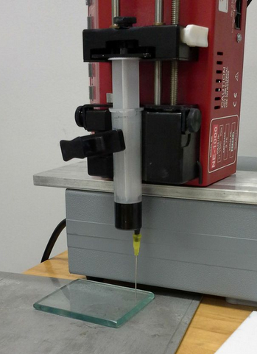
Current Experiments
  Nano-powders added to the mixture
  Achieved desired percentage of CNT
  Tested with different gauge size needles
  Varied flow rate
  Excess material control
Figure 4.
Experimental setup
Figure 5.
Extrusion of polymer mixed with CNT
Samuel Yang

Slide 9
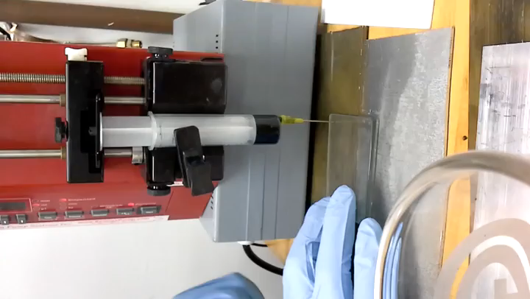
Testing / Experiments
Samuel Yang

Slide 10
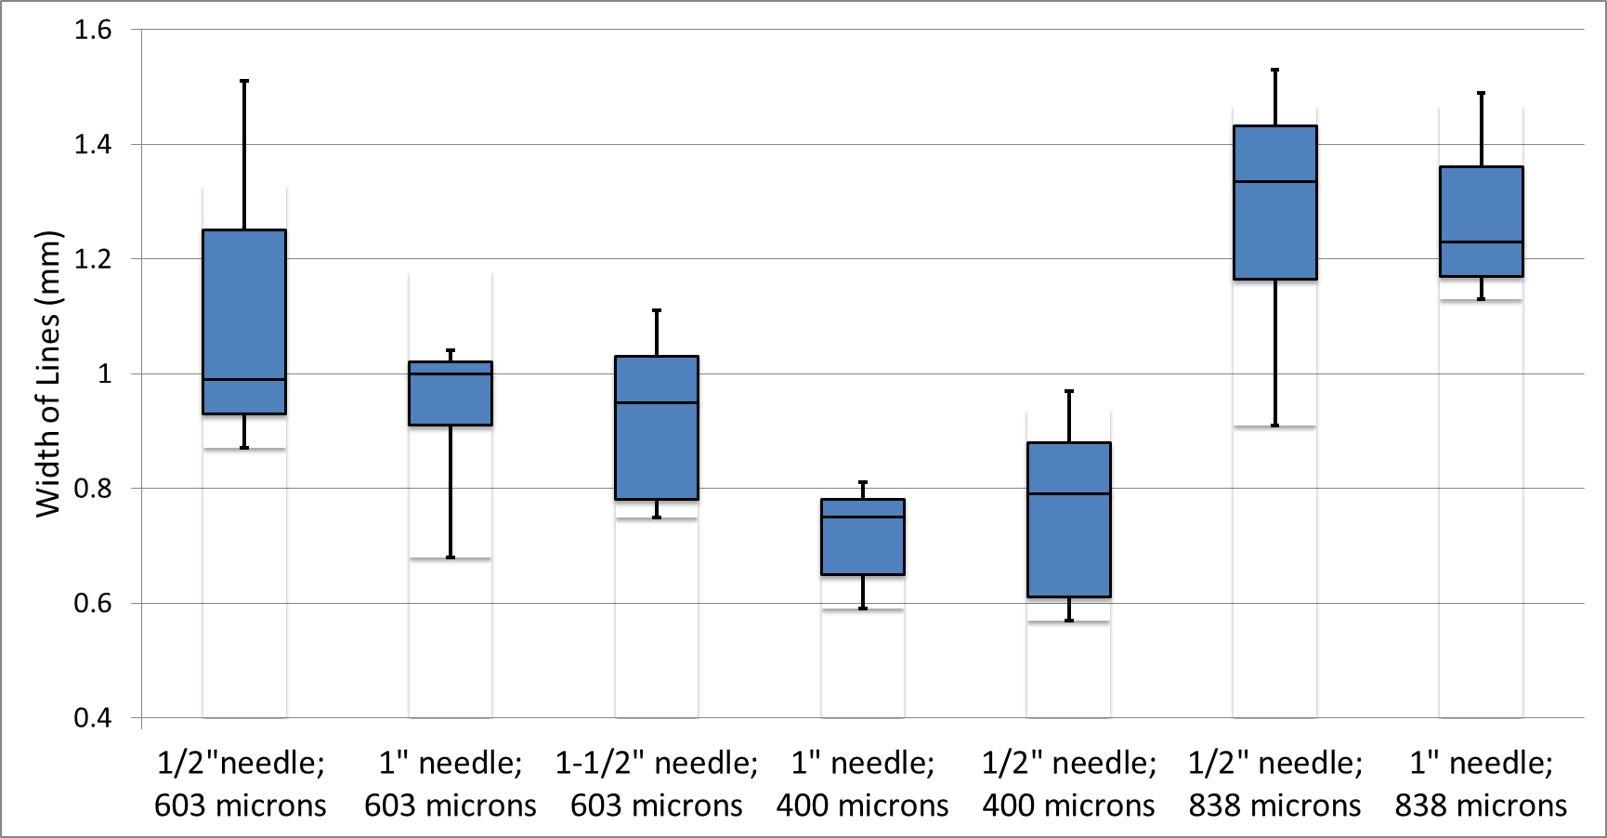
Testing / Experiments
Samuel Yang

Slide 11
Prototype Assembly

Slide 12
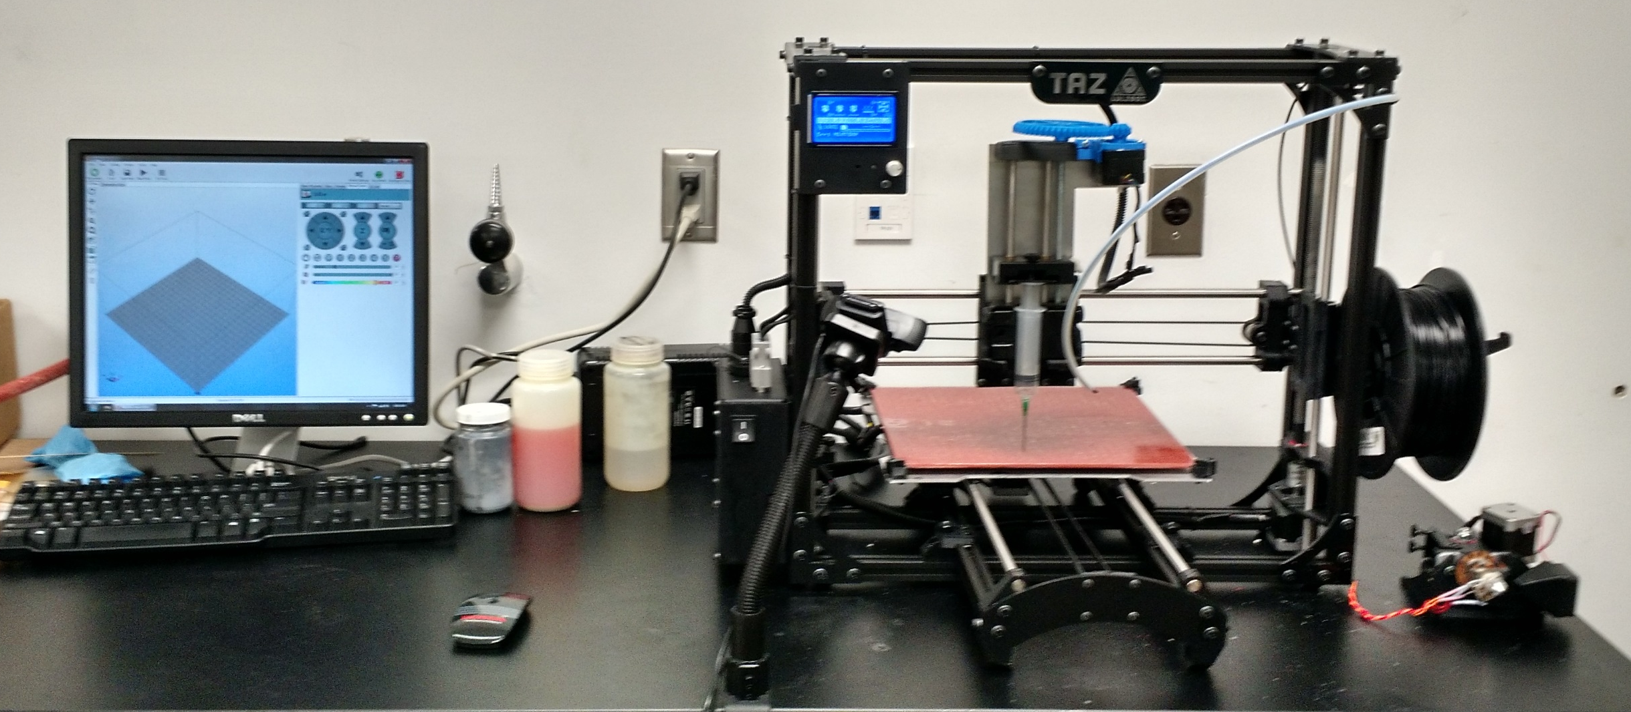
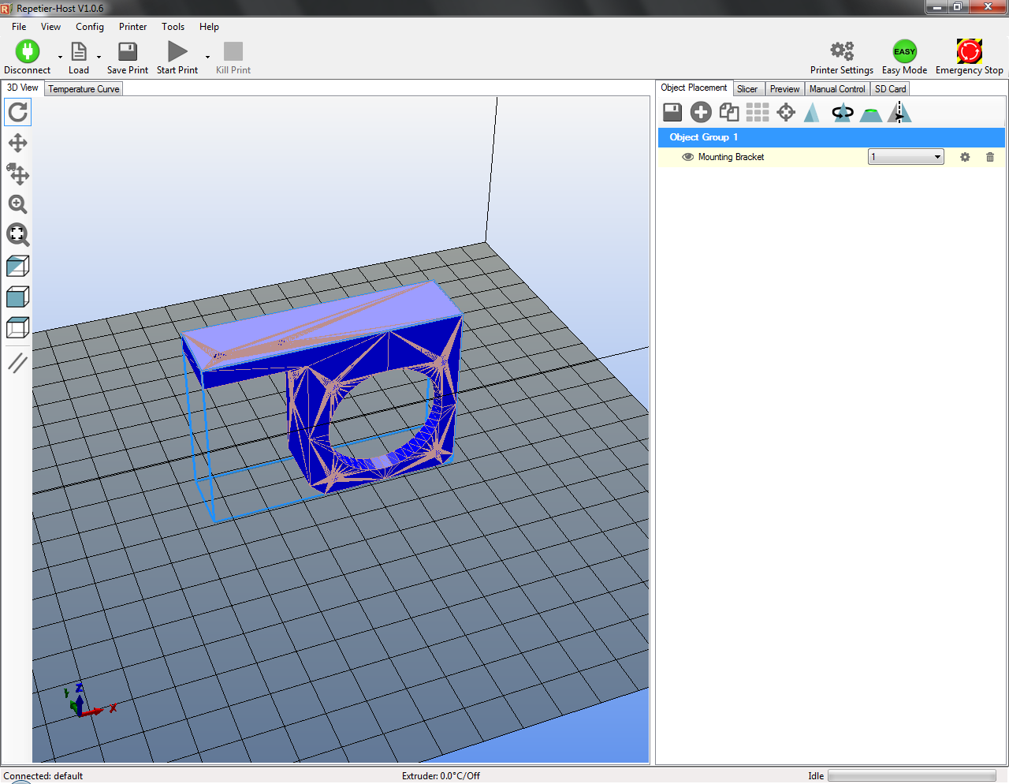
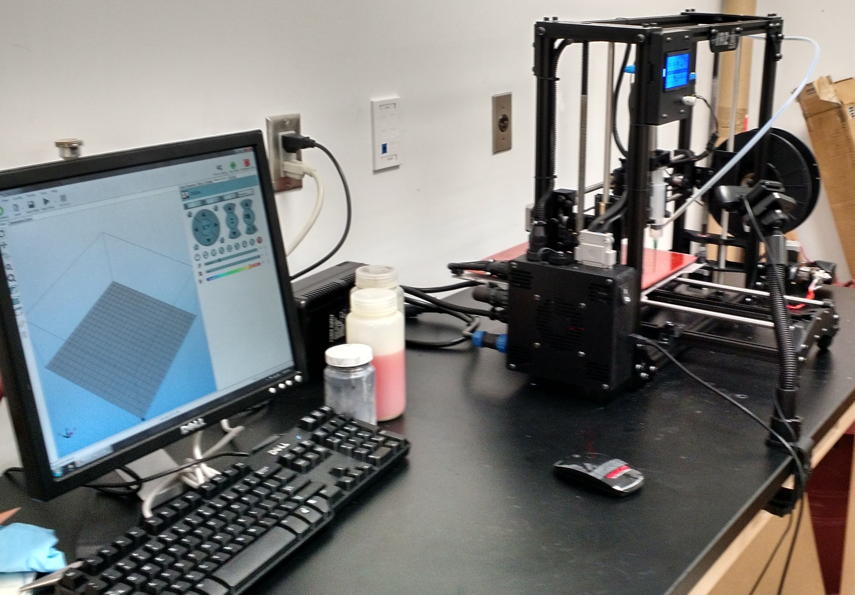
PC Control & Lab Setup
Repetier-Host
Netfabb Basic
TeamViewer
Solidworks
Cody Evans

Slide 13
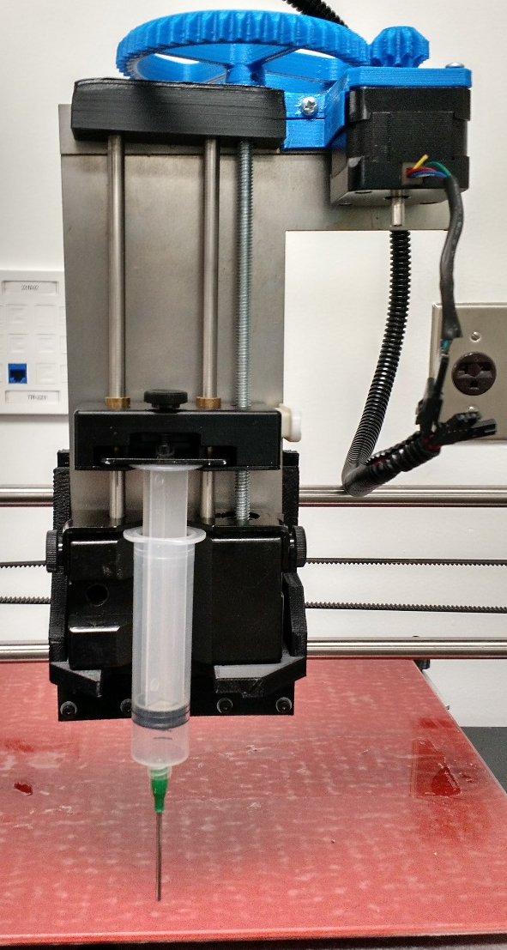
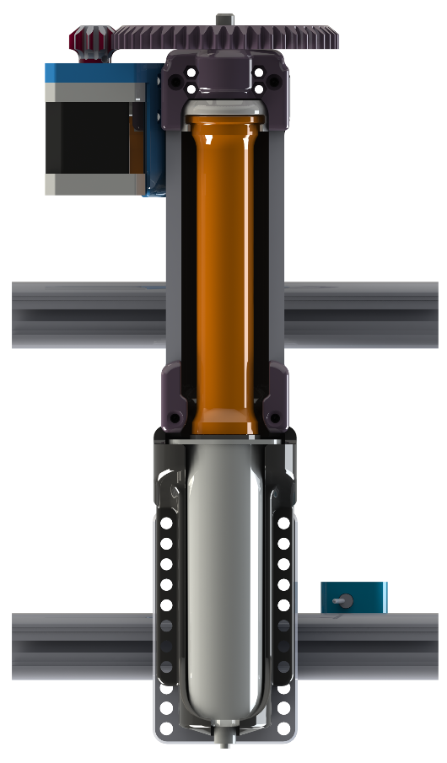
Variable Syringe Pump
Cody Evans

Slide 14

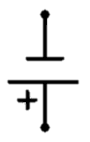
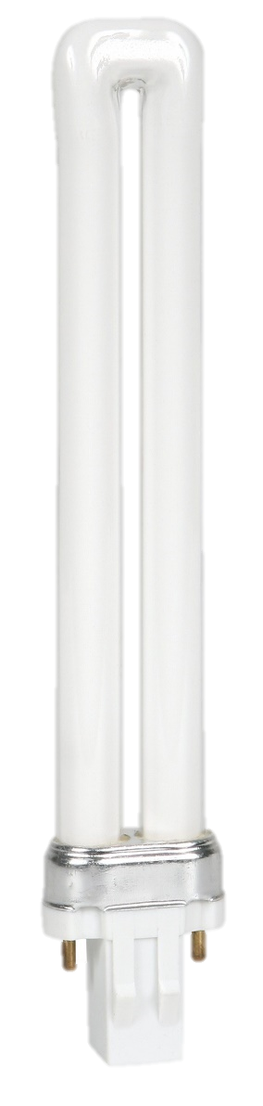

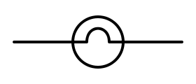
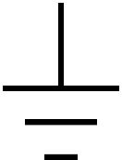
Curing Lamp Array
120V AC Supply
5V Supply
5V Switching Signal
Syringe
4 x 9W Fluorescent Lamps
Power Board
Cured Part
Cody Evans

Slide 15
Future Actions
Mount UV lamps
Adjust printer profile to adjust extrusion process
Submit printed parts for sponsor approval

Slide 16
Questions?
http://eng.fsu.edu/me/senior_design/2015/team19/

